Slide 1
IEC TC57 WG15 – Data and Communication Security
Status & Roadmap
March, 2016
Frances Cleveland
Convenor WG15

Slide 2
Topics
Mission and Scope of WG15
Members
Accomplishments
Current and new work
Roadmap
Issues

Slide 3
Mission and Scope of WG15 on Cybersecurity
Undertake the development of standards for security of the communication protocols defined by the IEC TC 57
  Specifically the IEC 60870-5 series, the IEC 60870-6 series, the IEC 61850 series, the IEC 61970 series, and the IEC 61968 series.
  Review and advise on cyber security of TC57 standards
Undertake the development of standards and/or technical reports on end-to-end security issues.
Notes:
The WG15 scope is the security of the IEC TC57 defined protocols and the end-to-end security issues

Slide 4
WG15 Members
92 members
Participants from 19 countries
  Argentina
  Canada
  China
  Croatia
  Denmark
  Finland
  France
  Germany
  Great Britain
  India
  Italy
  Japan
  Korea
  Russia
  South Africa
  Spain
  Sweden
  Switzerland
  USA

Slide 5
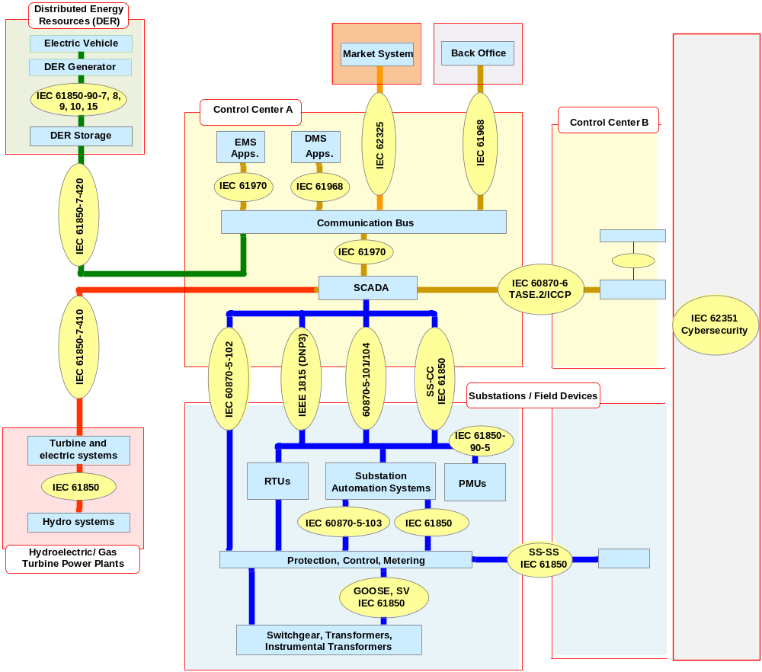
IEC TC57 WG15 Architecture of Information Standards

Slide 6
Mapping of TC57 Communication Standards to IEC 62351 Security Standards
IEC TC57 Power System Communication Standards
IEC 62351 Security Standards
IEC 62351-1: Introduction
TS Ed.1 – 2007
IEC 60870-6 TASE.2 (ICCP)
IEC 62351-2: Glossary
TS Ed.1 – 2008
IEC 60870-5-104 & DNP3
IEC 62351-3: Profiles including TCP/IP
IEC 60870-5-101 & Serial DNP3
TS Ed.1 – 2007, IS10/2014
IEC 62351-4: Profiles including MMS and similar Payloads
IEC 61850 GOOSE and SV
TS Ed.1 – 2007, CDV 06/2016
IEC 62351-8: Role based
Access Control (RBAC)
IEC 62351-9:
Key Management
IEC 62351-5: IEC 60870-5 and Derivates
IEC 62351-7: Objects for
Network Management
IEC 62351-14:
Cyber Security Event Logging
IEC 61850-8-1 with MMS
CD Ed.1 – 2013, CD2 – 03/2015, CDV 01/2016
TS Ed.1 – 2010, FDIS 6/2016, IS 12/2016
NWIP 01/2016
TS Ed.1 – 2009, TS Ed.2 – 04/2013
TS Ed.1 – 2011, RR 06/2016
IEC 61850-8-2 XML over XMPP
IEC 62351-6: IEC 61850 Profiles
IEC 61970 & IEC 61968 CIM
TS Ed.1 – 2007, CD 06/2016
IEC 62351-11: Security
for XML Files
FDIS 12/2015, IS 06/2016
IEC 62351-100 Conformance Testing
IEC 62351-90-1: RBAC Guidelines
DC 06/2016
IEC 62351-90-2: Deep Packet Inspection
DC 06/2016
IEC 62351-10: Security architecture guidelines for TC 57 systems
IEC 62351-100-1:
IEC 60870-5-7 (Part 3/5)
TR Ed.1 – 2012
IEC 62351-12: Resilience and Security Recommendations for Power Systems with DER
NWIP prepared
DTR– 01/2016, TR mid-2016
IEC 62351-13: What Security Topics Should Be Covered in Standards and Specifications
DTR 01/2016, TR mid-2016

Slide 7
Status of IEC 62351 Parts
IEC 62351 Part | Released | Activities (by January 2016) | Planned Release (New)
IEC/TS 62351-1: Introduction | 2007 | May need to be updated
IEC/TS 62351-2: Glossary of terms | 2008 | Review Report pending | Pending
IEC/IS 62351-3: Security for profiles including TCP/IP | 2014 |  | IS Ed. 2 in 2014
IEC/TS 62351-4: Security for profiles including MMS | 2007 | Work on the A Profile enhancements. How much of the XMPP should be addressed here since security is discussed in 61850-8-2? | IS Ed. 2: CDV 7/2016, FDIS 12/2016, IS Jun 2017
IEC/TS 62351-5: Security for IEC 60870-5 and derivatives | 2013 | Released April 2013 | RR for IS process to be issued ?/2016;
IEC/TS 62351-6: Security for IEC 61850 profiles | 2007 | Updates underway, based on security requirements in IEC 61850-90-5 | RR was issued mid-2014, CD 7/2016 in parallel with Part 4
IEC/TS 62351-7: Objects for Network Management | 2010 | CD issued 1/2015, responded to CD1 comments, updating UML model | CDV 12/2015, FDIS 6/2016, IS 12/2016
IEC/TS 62351-8: Role-Based Access Control | 2011 | Discussions on developing categories of roles | Issue RR for IS by 6/2016 after TR 90-1 issued
IEC/IS 62351-9: Key Management | Pending | CDV in early 2016 | CDV by 2/2016 and FDIS in mid 2016, IS in late 2016
IEC/TR 62351-10: Security Architecture | 2012 | TR published Oct 2012
IEC/IS 62351-11: Security for XML Files | 2016 | Going out as FDIS | FDIS 12/2015, IS 6/2016
IEC/TR 62351-12: Resilience and Security Recommendations for Power Systems with DER | 2016 | Sent out as DTR 1/2016 | DTR 1/2016
IEC/TR 62351-13: Guidelines on What Security Topics Should Be Covered in Standards and Specifications | 2016 | Sent out as DTR 2/2016 | DTR 2/2016
IEC/TR 62351-90-1: Guidelines for Using Part 8 Roles | DC in 2016 | Actively being developed | WD 3/2016, DC 6/2016, TR maybe by 12/2016 if 2nd DC not needed
IEC 62351-100-1: Conformance test cases for IEC 62351-5 and companion standards | NWIP 2016 | Starting with conformance testing of IEC 62351-3, 62351-5, and 60870-5-7 | NWIP by 2/2016
IEC 62351-14 Security Event Logging and Reporting | PWI NWIP | Based on existing security logging | NWIP by 3/2016
IEC/TR 62351-90-2 Deep Packet Inspection | PWI DC Pending | TR to discuss the issues around deep packet inspection | DC 6/2016, DTR 12/2016

Slide 8
IEC 62351 Roadmap for WG19
Complete Work | Updates and New Work in Process | Potential New Work
Parts 1, 2, 3, 4, 5, 6, 7, 8, and 10 – finalized as TRs or TS Documents (Ed 1) Part 5 as TS Ed 2 | Part 2 Glossary: adding amendments probably update in 2014 Part 3 Security using TLS: Submitted as FDIS Dec 2013 as IS by 2014 Part 4 Security for MMS: Edition 2 started Part 5 Security for IEC 60870-5 and Derivatives: Amendment or Corrigendum Part 6 on IEC 61850: develop RR for updates to equivalent to IEC 61850-90-5 Part 7 Network and System Management: update process to Ed 2 started in 2013 Part 8 developing TR 62351-90-1 as Guidelines for using RBAC Part 9 Key Management: 2nd CD to be issued Part 11 Security for XML Files: CD issued Part 12 Resilience and Security for Power Systems with DER: DC issued Part 13 What Security Topics Should Be Covered in Standards and Specifications Part 14: SysLog Part 90-2: Deep Packet Inspection Part 100-1: Conformance Testing for Part 5 Security profiles for web services including XMPP (IEC 62351-4 for encoding rules and 61850-8-2) | Assess cyber security in IEC TC57 documents such as IEC 62325-504 Explore customer premises security issues with WG21

Slide 9
Liaisons with Other Security Activities
Liaison with ISO JTC 1 / SC 27 IT Security:
  WG15 has provided lists of Smart Grid security standards and related documents to SC27.
  WG15 has received documents in the 270xx series on general cybersecurity and has commented on the proposed 27019 standard on power industry cybersecurity.
  WG15 welcomes the publication of ISO/IEC TR 27019 as an important step for the establishment of a sector specific ISMS and cyber security standard for the energy domain. WG15 expects to take an active liaison role during any revision of the TR or its transformation into an IS. TC 57 / WG15, as the IEC committee responsible for cyber security of the energy domain will support such revisions by contributing its domain expertise on organizational, operational, and regulatory cyber security requirements for energy utilities.
Liaison D with M/490 SGIS:
  WG15 is exchanging information with SGIS
Liaison D with UCAIug:
  Discussions with members of SG-Security in UCAIug on areas of mutual interest are underway.
Liaison A with IEC TC65C which is standardizing the work of the ISA SP99 Security Standards.
  Some WG15 members have reviewed and commented on IEC 62443 drafts
Liaison D with the IEEE PES PSCC Security Subcommittee
  Working with IEEE Substations on Cybersecurity Standard IEEE 1686
Working on Liaison with ITU-T

Slide 10
Coordination with Security Groups
Coordination mostly through common membership:
  NIST’s Smart Grid Interoperability Panel (SGIP) Smart Grid Cybersecurity Committee (SGCC)
  NERC CIPs
  Cigré D2.40
  MultiSpeak Security / Security for Web Services (e.g. WS-Security)
  ITU-T
  IEC TC13
  US EPRI
  ENTSO-E

Slide 11
Issues
Although we have cybersecurity experts, they are very busy
Cybersecurity is a very dynamic, rapidly changing field which is quite new for the power industry
  Are coordinating with other TC57 WGs to review cyber security in their documents
  Need to coordinate with other industries and standards groups
  Need rapid development of new standards and updates to existing standards
  Need guidelines for end-to-end security, but only for very specific aspects
  Need both standards and technical reports
  Need input from power system domain experts on security requirements
  Need to assist TC57 developers of standards to include appropriate cyber security requirements
Need conformance and/or interoperability testing for IEC 62351
  Abstract conformance test cases should be in each Part, with IEC 61850-10 providing specifics for 61850
  Interoperability testing?

Slide 12
Questions? Comments?
Publicly available WG15 web page with additional information: http://iectc57.ucaiug.org/wg15public/default.aspx

